Slide 1

Efficient Data Hiding System Using LZW Cryptography And Image Steganography With A Hybrid Approach

Slide 2
Abstract
The combination of steganography and cryptography is considered as one of the best security methods used for message protection, due to this reason, in this project, a data hiding system that is based on image steganography and cryptography is proposed to secure data transfer between the source and destination.
A hybrid approach of cryptography, data compression and steganography has been proposed in this project. Motivation behind this project is to provide a smart image steganographic technique which must be capable enough to provide better quality stego-image with a high data hiding capability.
Hybrid Approach can reduce the time of transmission of data

Slide 3
Area Of Study:-
Cryptography
Steganography
LZW Compression Method
Hybrid Approach

Slide 4
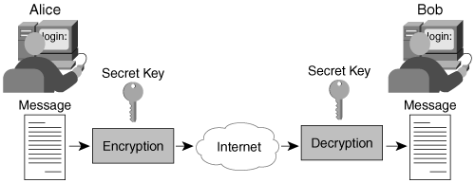
Cryptography:-
Cryptographic techniques, “scramble” messages so if intercepted, the messages cannot be understood.

Slide 5
Encryption/Decryption by using:-
Factors | AES | DES | RSA
Developed | 2000 | 1977 | 1978
Key Size | 128, 192, 256 bits | 56 bits | >1024 bits
Block Size | 128 bits | 64 bits | Minimum 512 bits
Encryption | Faster | Moderate | Slower
Decryption | Faster | Moderate | Slower
Power Consumption | Low | Low | High
Security | Excellent Secured | Not Secure Enough | Least Secure
Hardware & Software Implementation | Faster | Better in hardware than in software | Not Efficient

Slide 6
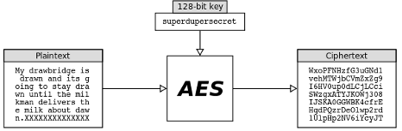
Advanced Encryption Standard (AES):-
Advanced Encryption Standard (AES) algorithm not only for security but also for great speed. Both Hardware and software implementation are faster still.
Encrypts data blocks of 128 bits in 10, 12 and 14 round depending on key size.
It can be implemented on various platforms specially in small devices.
It is carefully tested for many security applications.

Slide 7
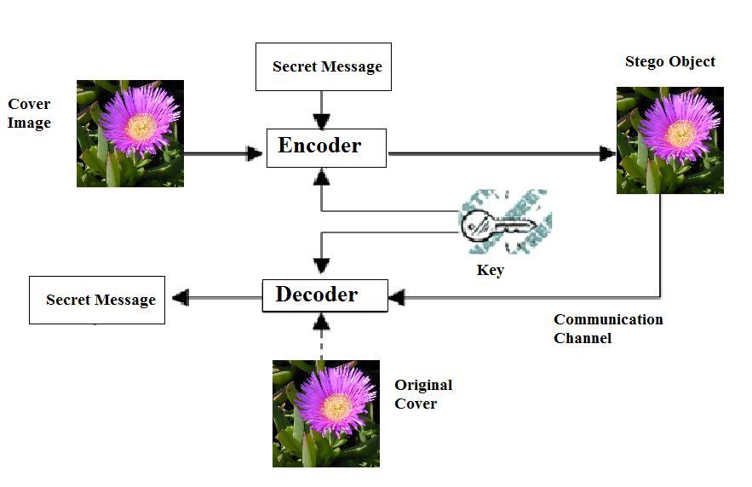
Steganography:-
Steganography is a technique to Hiding data into another data.
OR
Steganography, in an essence, “cover-ups” a message to hide its existence and make it seem “invisible” thus concealing the fact that a message is being sent altogether.

Slide 8
Algorithm For Concealing Message:-
LSB (Least Significant Bits) algorithm :-
LSB algorithm is employed to hide the message inside the colors of the pixels of an animated GIF image frames.
Example:-
We can use images to hide things if we replace the bit of every color’s byte with a bit from the message.
Message A-01000001
Image with 3 pixels
Pixel 1: 11111000 11001001 00000011
Pixel 2: 11111000 11001001 00000011
Pixel 3: 11111000 11001001 00000011

Slide 9
Existing System
They proposed new approach wherein both cryptography and steganography are used to encrypt the data and also to conceal these encrypted contents in some other medium. In this method, we can secure Message File by converting it into an encrypted text using S-DES algorithm(Or Triple DES, AES, RSA, etc.) and a secret key and then concealing this encrypted text in some other image. This technique has been tested and it has been observed that they prevent the possibilities of steganalysis also.

Slide 10
Disadvantages Of This System:-
Current steganography project is having complexity problem in terms of time per Data. Now Days Steganography project can hide data in equal length of image file, For Example It can hide 1Mb data with At least(Or More than) 1Mb Image file, it means that For Extracting 1Mb data we have to download At least(OR more than) 2Mb file(i.e. 50% loss of Data OR more than 50% loss).
And also it’s cost of transmission is more. Second problem is, it takes more time for a complete transmission from sender to receiver.

Slide 11
Advantages Over Existing System:-
LZW compression scheme is used to optimize the size of secret data, it will enable a person to hide approx 2 times more data in a cover-image, i.e. Now we can store Double Amount of Data into Same Image File. This Way we can reduce the cost of data and we can also reduce loss of data upto 50%. This approach is secure against the RS detection attack and its stego-image is totally indistinguishable from the original image (cover-image) by the human eye.
And By using Hybrid Approch we can reduce transmission time by Extracting data parallelly at decoding time. This way we can reduce some amount of transmission time.

Slide 12
Hardware Requirements
Processor : Pentium Dual Core
Speed : 1.65 GHzs(Or more than)
Motherboard : Genuine Intel
RAM : 128Mb(Or more than)
Hard Disk Drive : 512Mb(Or more than)

Slide 13
Software Requirements
Operating System : Windows 7
Application Type : Windows App
IDE Platform : NetBeans
Coding Language : JAVA Programming

Slide 14
Block Diagram
At Sender End:- At Receiver End:-
Transmission
Decode
Decryption
Decompression
Message
Stop
Messages
Compression
Encryption
Encode
Transmission
Start
Input
Image File
Image File
Output

Slide 15
Thank You

